Slide 1

Noise In Artificial Spin Ices
Anujan Ganeshalingam

Slide 2
Objectives
[1] F. K. K. Kirschner et al. Proposal for the detection of magnetic monopoles in spin ice via nanoscale magnetometry. Phys. Rev. B, 97:140402, (2018).
[2] A. M. Samarakoon et al. Anomalous magnetic noise in an imperfectly flat landscape in the topological magnet Dy2Ti2O7. Proceedings of the National Academy of Sciences, 119(5), (2022).
Characterise the behaviour of noise spectral density of 2D nearest-neighbour spin ice model.
Find out which of the two contradicting papers are correct: Kirschner et al [1] or Samarakoon et al [2].
Use Monte Carlo method to check the form of the noise spectral density.
Notes:
Hypothesis: the second paper is oversampling, leading to wrong characterisation of the spin ice model

Slide 3
Overview
Background
Methods
Results
Future Directions

Slide 4
Background

Slide 5
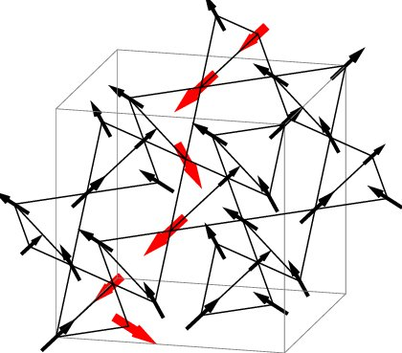
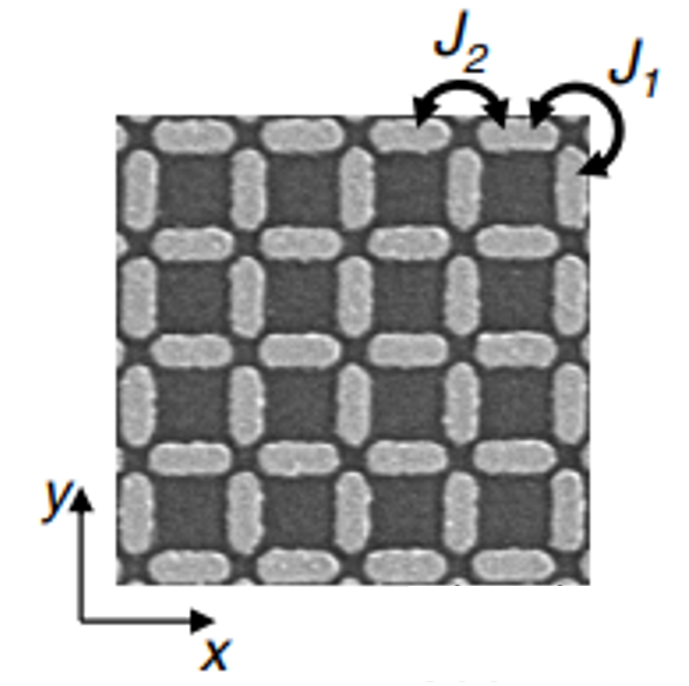
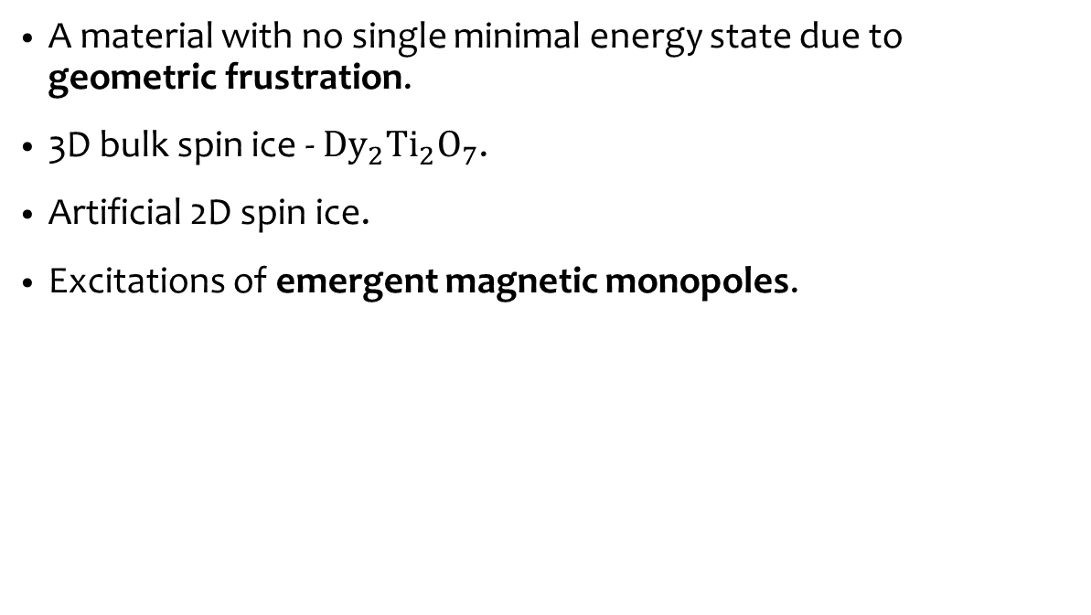
Spin Ice
Jaubert, L et al. (2009). The Kasteleyn transition in three dimensions: Spin ice in a [100] field. Journal of Physics Conference Series. 145. 10.1088/1742-6596/145/1/012024.
A material with no single minimal energy state due to geometric frustration.
3D bulk spin ice - $Dy_{2}Ti_{2}O_{7}$.
Artificial 2D spin ice.
Excitations of emergent magnetic monopoles.
M. Goryca, et al. Field-induced magnetic monopole plasma in artificial spin ice. Phys. Rev. X, 11:011042, March 2021.
Notes:
Spin ice is…
Frustration at its very simplest is when a system cannot minimise its spins
We see it here in a little triangular vertex
This geometric frustration is also seen in our spin ice materials – in 3D and 2D
Magnetic ions on the corner of the 3D pyrochlore lattice
Name comes from water ice – the state is minimised when there are two in two out
Similar for spin ices, two spins in and two out gives the minimum energy configuration
Spins pointing in or out
Doesn’t order at very small temperatures – therefore need noise spectral density since can’t get single monopoles

Slide 6
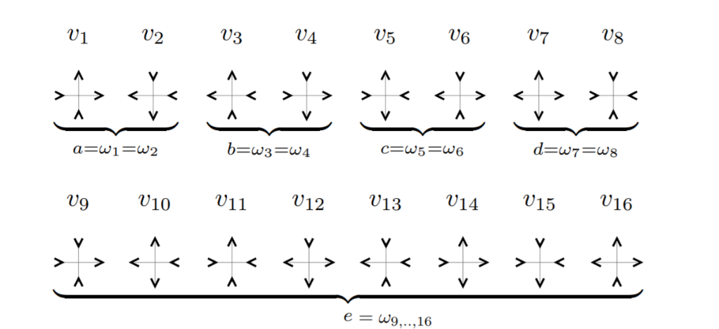
Nearest Neighbour Model
Spins along edges.
Finite configurations - 16 vertex model.
Energies of vertices known.
Excitations cause emergent magnetic monopoles.
D. Levis. Two-dimensional Spin Ice and the Sixteen-Vertex Model. PhD thesis, Universite Pierre et Marie Curie - Paris VI, (2012).
Notes:
This idea can be done in 2D than 3D and get equivalent results therefore we do this in 2D since it is computationally easier
Spins are along the edge
Only 16 possible configurations of the spins in 2x2 vertices
The energies of the vertices are all already known from calculation by Levis from the coupling constants

Slide 7
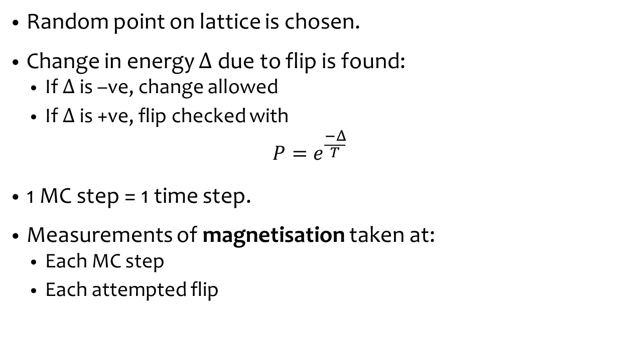
Monte Carlo Method
Random point on lattice is chosen.
Change in energy $Δ$due to flip is found:
If $Δ$ is –ve, change allowed
If $Δ$ is +ve, flip checked with
$$P=e^{\frac{−Δ}{T}}$$
1 MC step = 1 time step.
Measurements of magnetisation taken at:
Each MC step
Each attempted flip
Notes:
The monte carlo method is an iterative method, which you can give probabilities of events occurring and simulate certain scenarios
Using the nearest neighbour model
A random spin is chosen to be flipped
Show flipping spin affects 2 vertices
Cost of flip found
Negative allowed
Positive compared to a random value between 0 and 1 – allowed if P is bigger
2 method are checked, one by Kirscher et al measured once each MC step, whereas Samarakoon measured once each time a flip was checked to be flipped

Slide 8
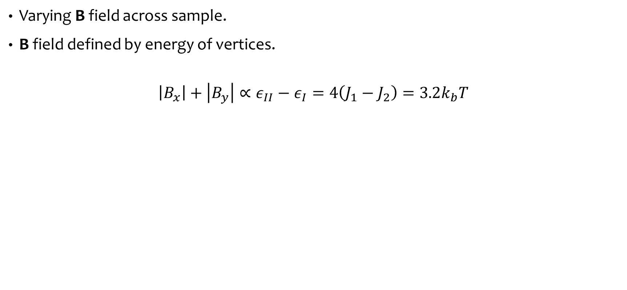
Dynamics of Monopoles
M. Goryca, X. Zhang, J. Li, A. L. Balk, J. D. Watts, C. Leighton, C. Nisoli, P. Schiffer, and S. A. Crooker. Field-induced magnetic monopole plasma in artificial spin ice. Phys. Rev. X, 11:011042, March 2021.
Varying B field across sample.
B field defined by energy of vertices.
$$\left|B_{x}\right|+\left|B_{y}\right|∝ε_{II}−ε_{I}=4\left(J_{1}−J_{2}\right)=3.2k_{b}T$$
Notes:
Mainly similar idea to the statics from earlier, but now considering a changing applied magnetic field than changing the temperature to find a phase transition
The B field is “changed” by changing the energy of the vertices and implemented through temperature changes
Applied B fields into sample given by the difference between energy of vertices group I and II
These are predefined, so 4 lots of differences between J1 and J2 which are coupling constants between the spins

Slide 9
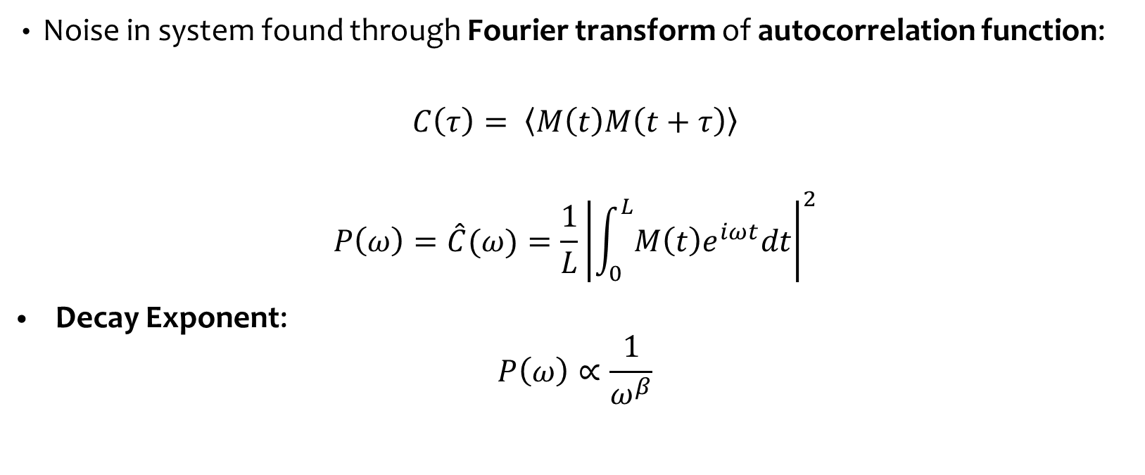
Power Spectral Density
Noise in system found through Fourier transform of autocorrelation function:
$$C\left(τ\right)= \left\langle M\left(t\right)M\left(t+τ\right)\right\rangle$$
$$P\left(ω\right)=\hat{C}(ω)=\frac{1}{L}{\left|\int_{0}^{L}{M\left(t\right)e^{iωt}dt}\right|}^{2}$$
Decay Exponent:
$$P\left(ω\right)∝\frac{1}{ω^{β}}$$
Decay Exponent | Colour
2 | Red/Brownian
1 | Pink
0 | White
Notes:
Noise in the system is found in terms of the frequency – this is found by Fourier transforming the autocorrelation function
ACF measures the similarity between 2 time series data, here the magnetism

Slide 10
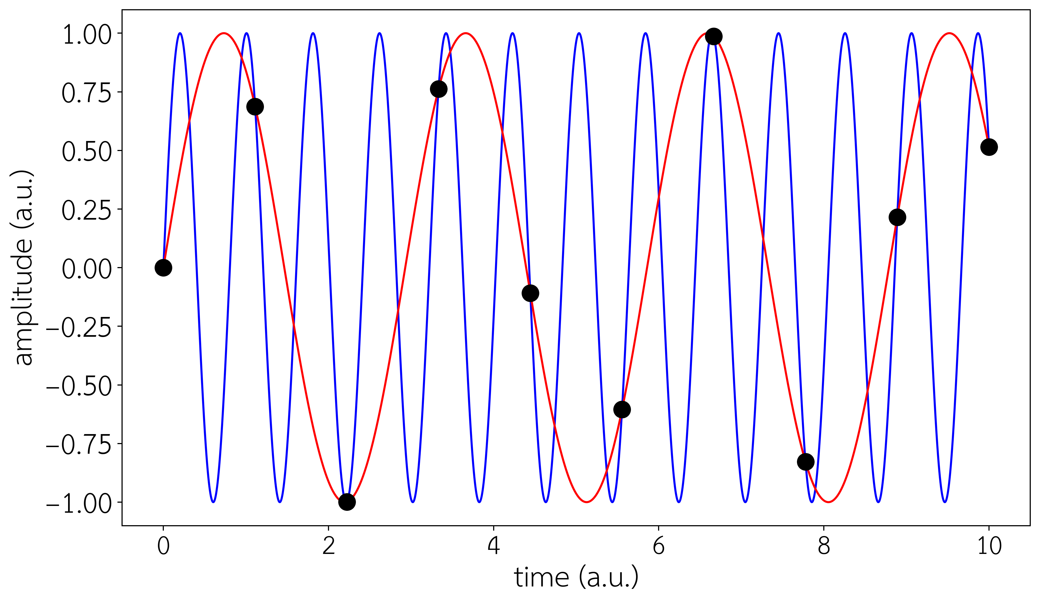
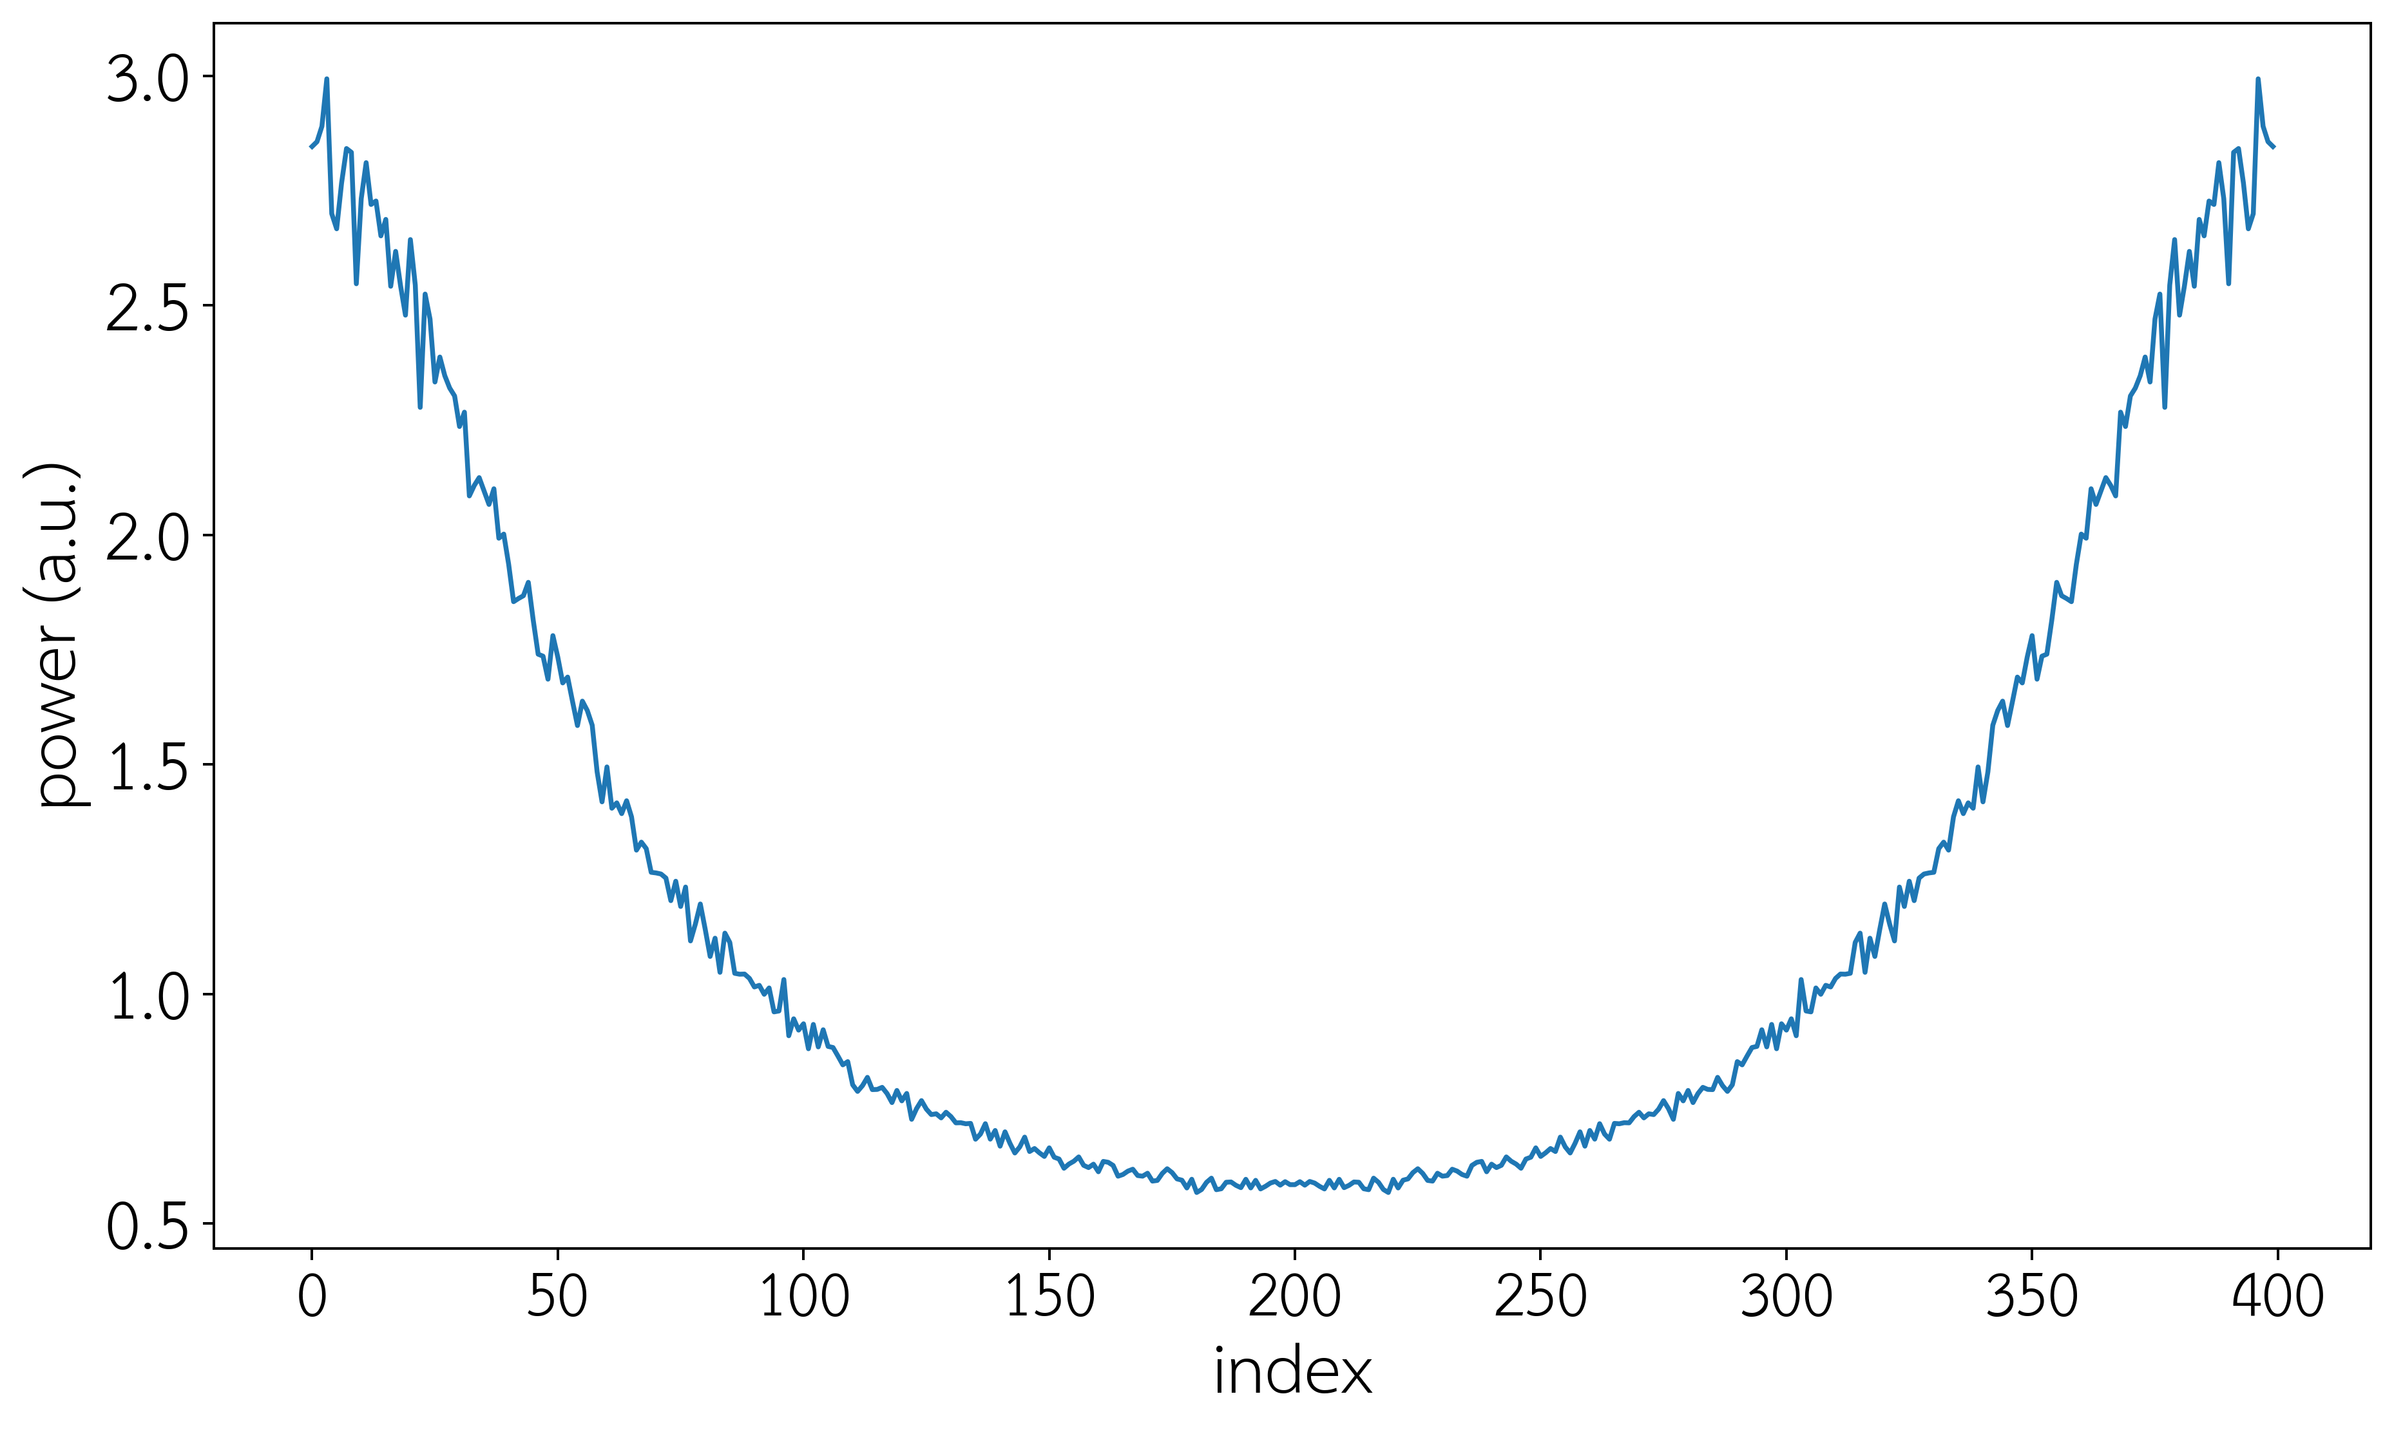
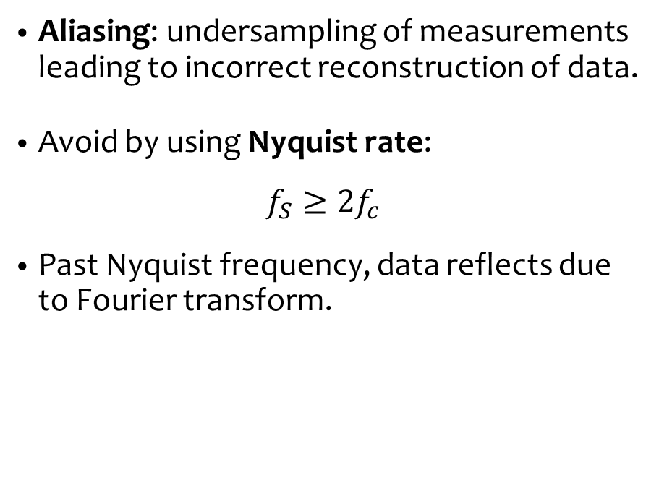
Nyquist Frequency
Aliasing: undersampling of measurements leading to incorrect reconstruction of data.
Avoid by using Nyquist rate:
$$f_{S}≥{2f}_{c}$$
Past Nyquist frequency, data reflects due to Fourier transform.
Notes:
Nyquist freq is an important idea
Arises from the rate at which we must sample for Fourier transform
Too slow, get aliasing as seen here
Too fast, oversample and go past real Nyquist frequency and get nonsense results

Slide 11
Results

Slide 12
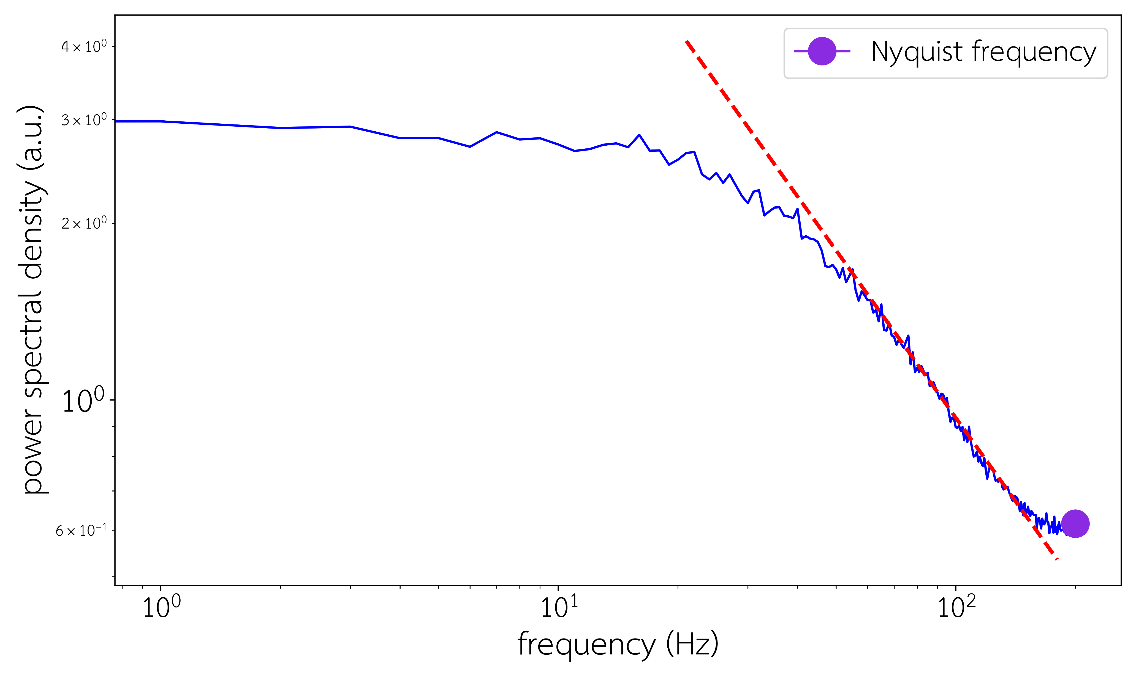
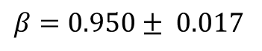
Measurement per MC step
$$β=0.950± 0.017$$
Notes:
At T = 0.6K

Slide 13
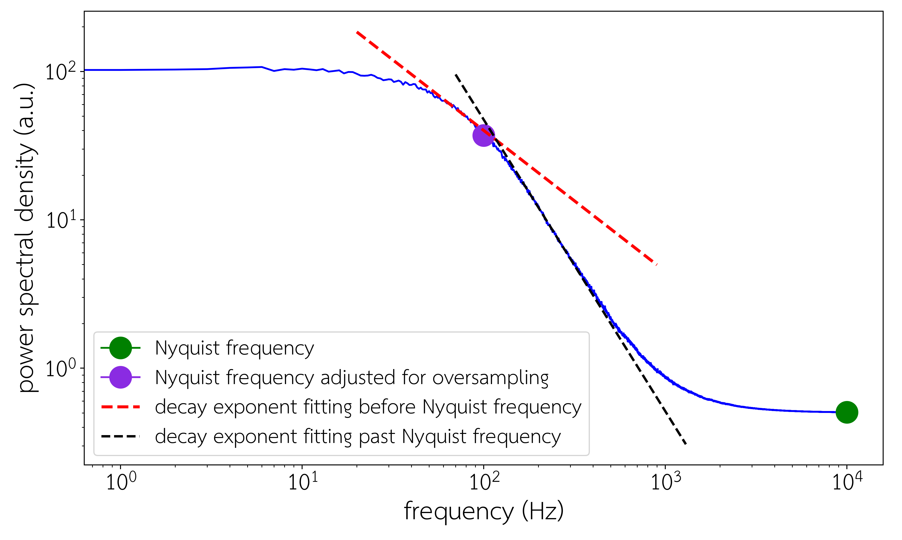
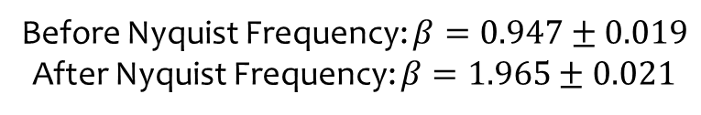
Measurement per Attempted Flip
Before Nyquist Frequency: $β=0.947±0.019$
After Nyquist Frequency: $β=1.965±0.021$

Slide 14
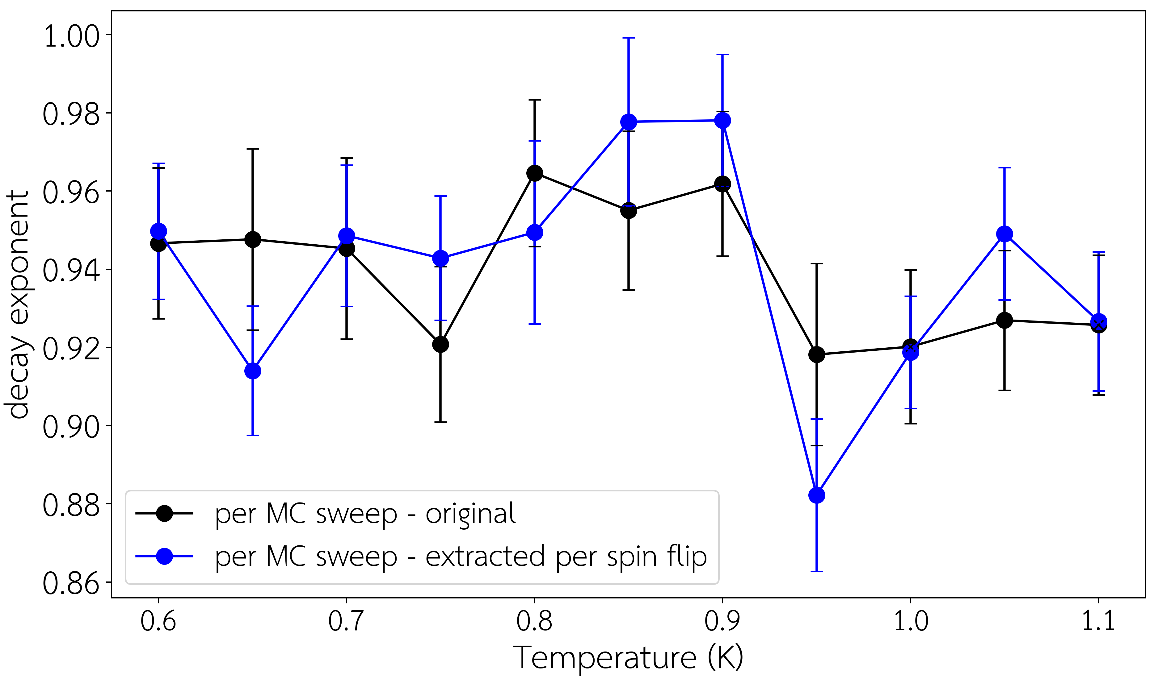
Comparison of Methods

Slide 15
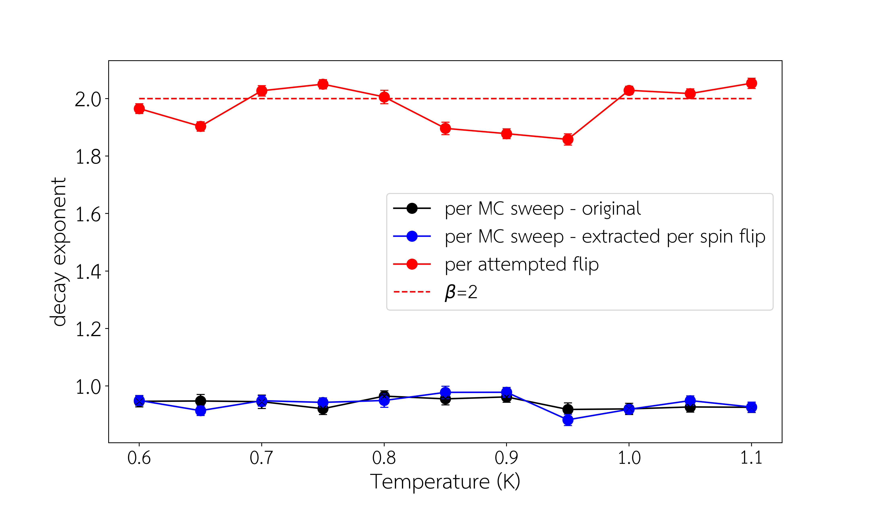
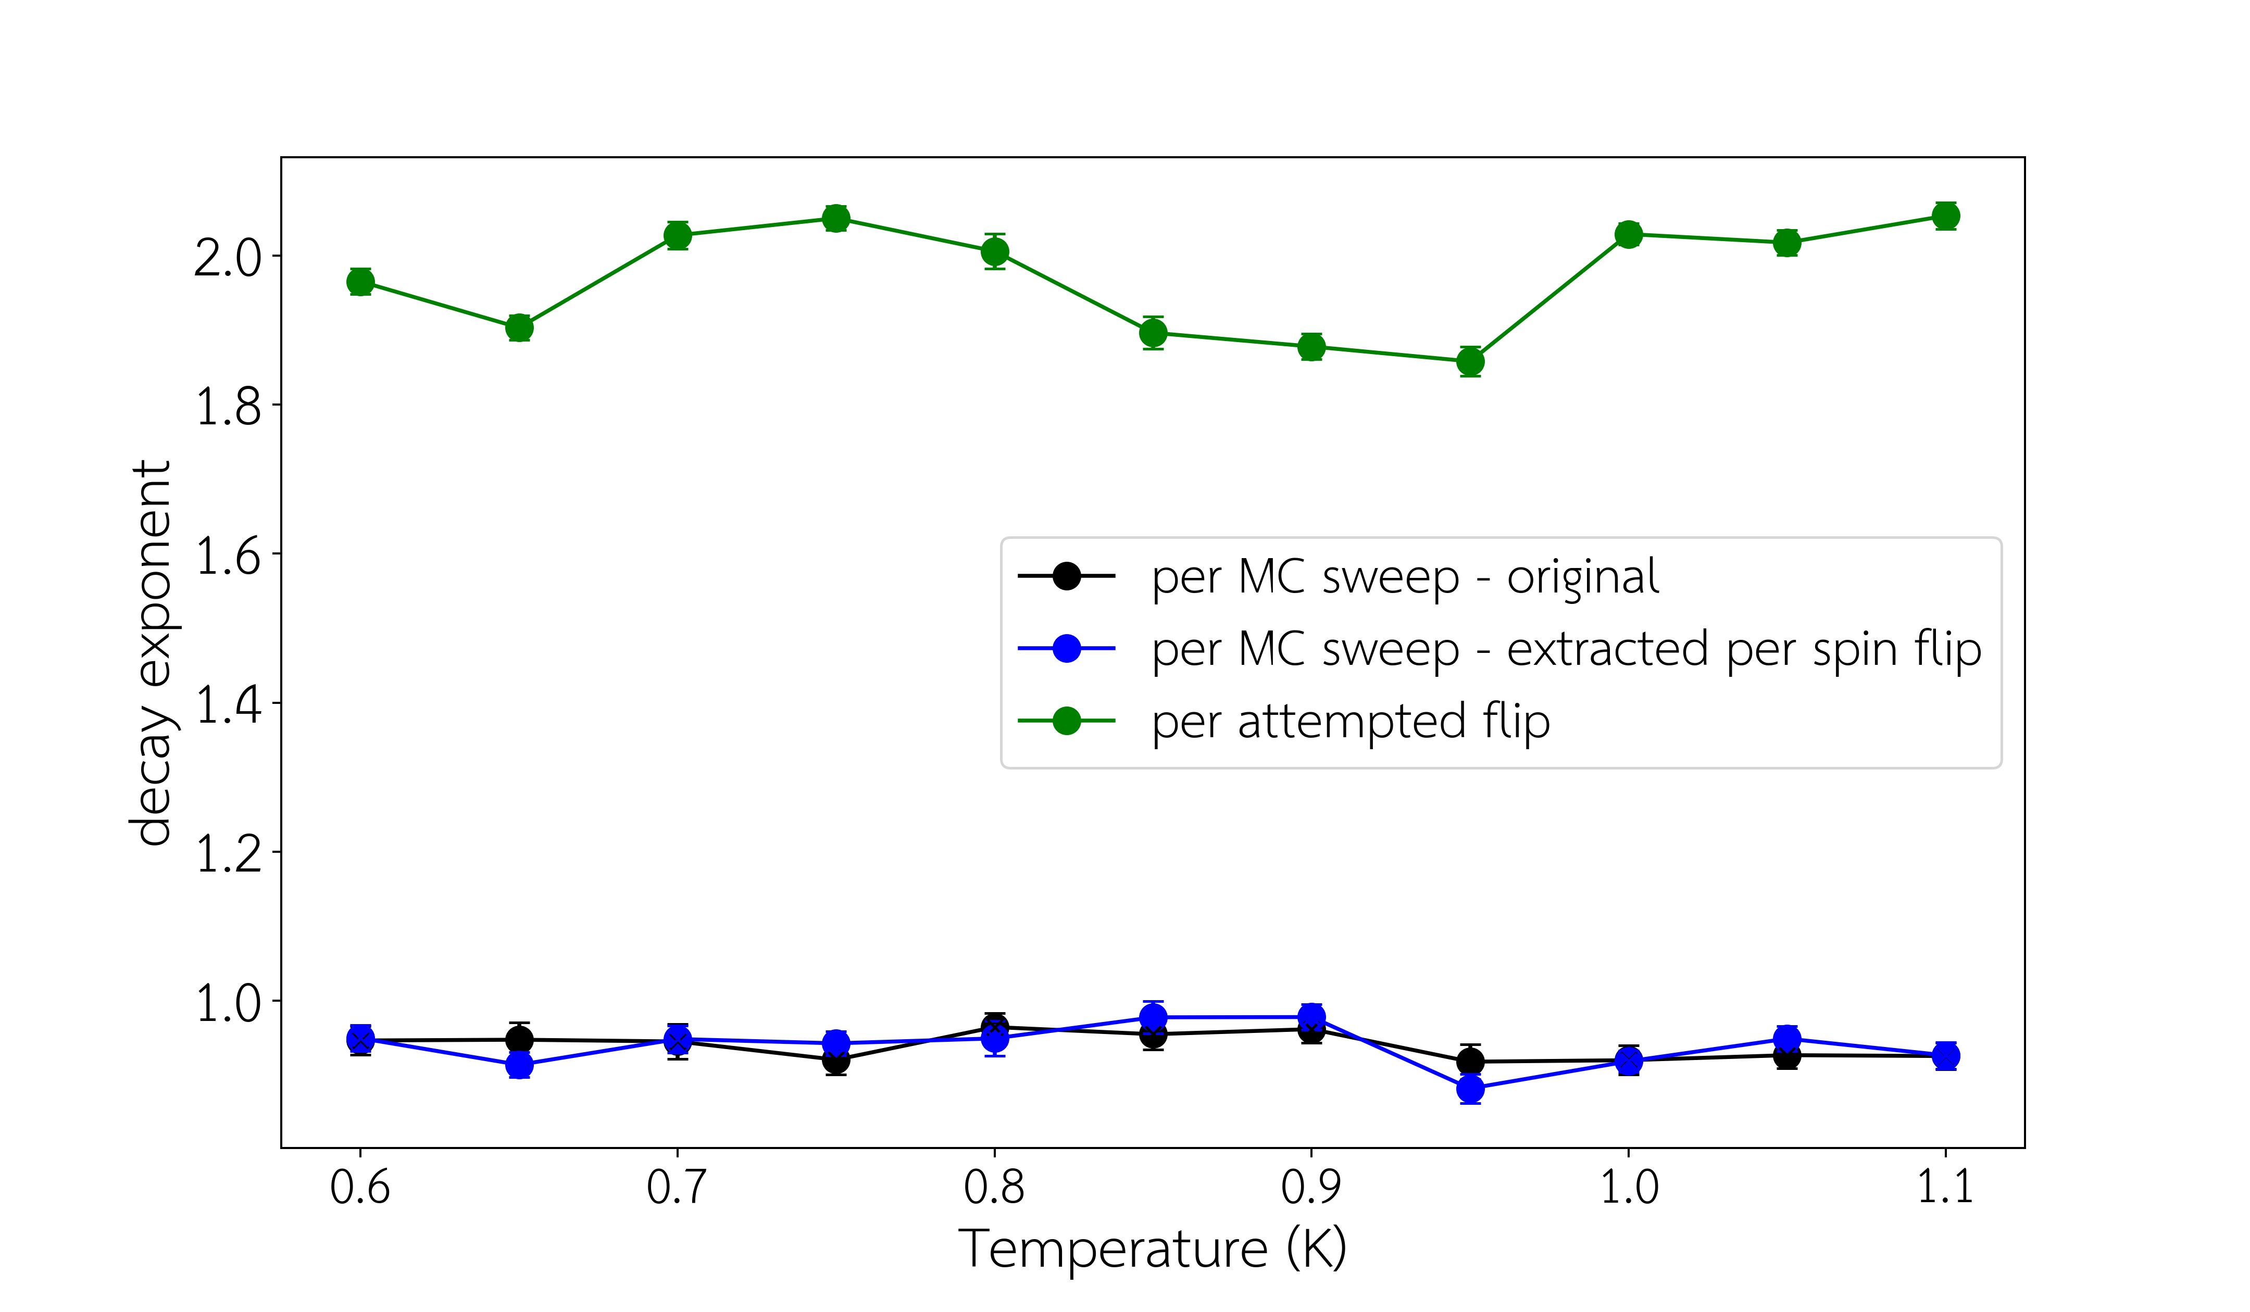
Comparison of Methods

Slide 16
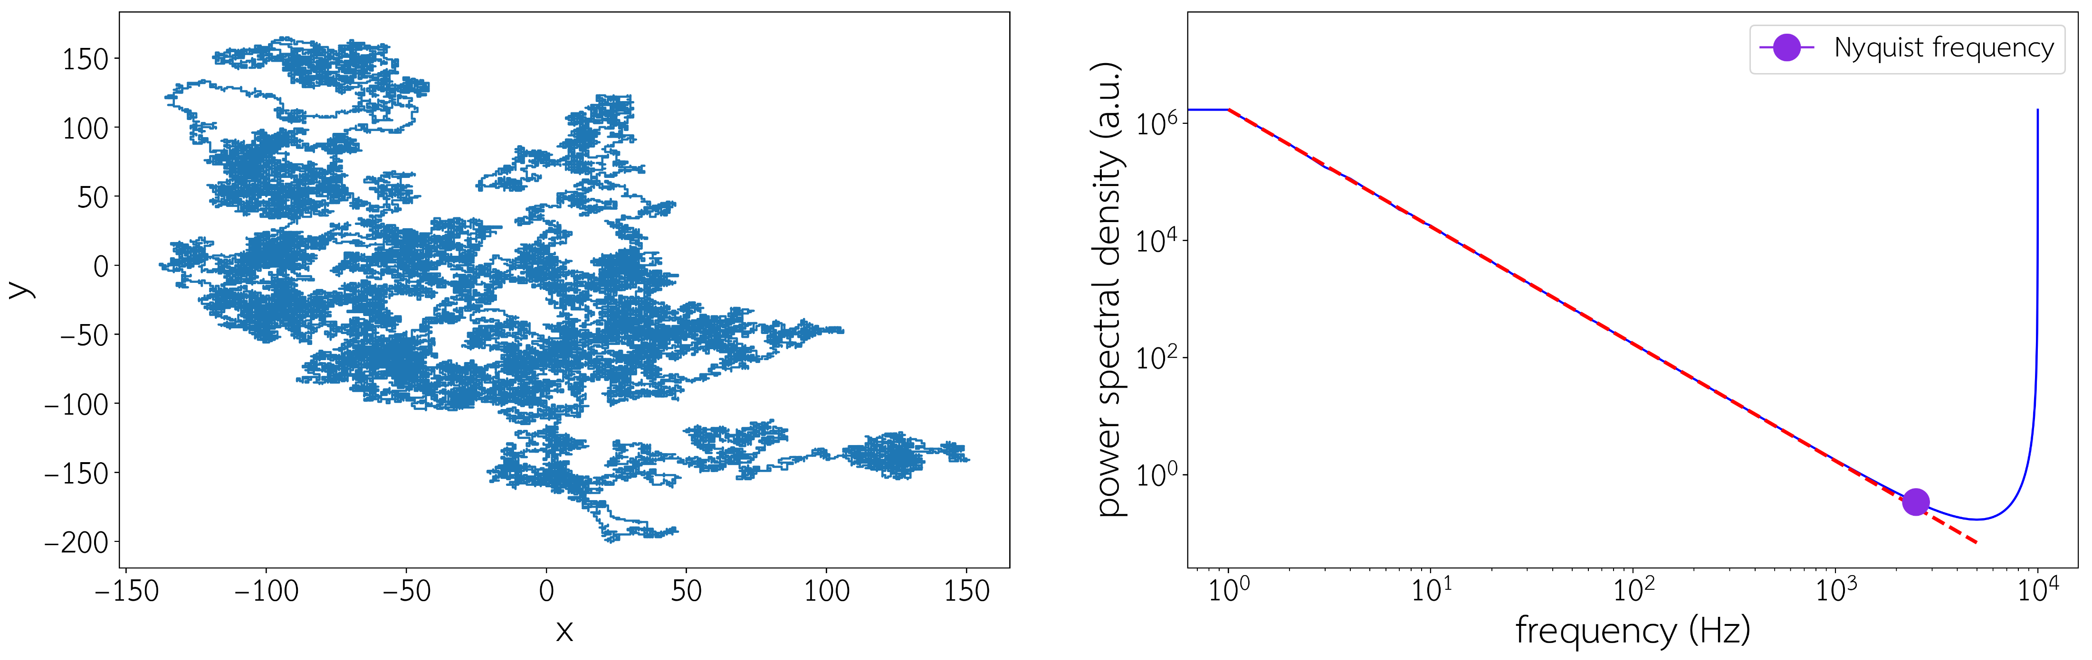
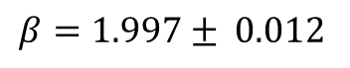
Unconstrained Random Walks
$$β=1.997± 0.012$$

Slide 17
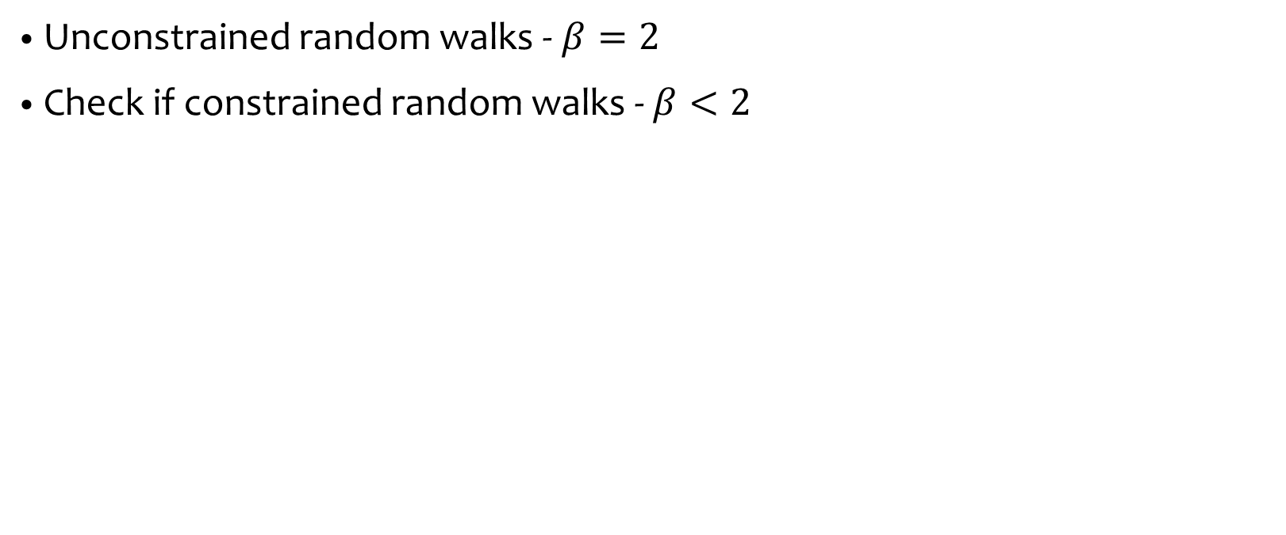
Future Work
2-in 2-out
Unconstrained random walks - $β=2$
Check if constrained random walks - $β<2$
2-in 2-out
3-in 1-out
4-in 0-out
Not allowed

Slide 18
Any questions?

Slide 19
Some extra stuff

Slide 20
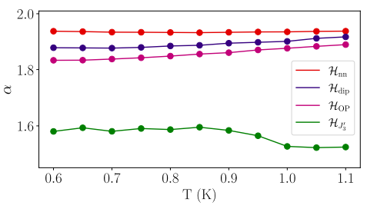
A. M. Samarakoon, S. A. Grigera, D. A. Tennant, A. Kirste, B. Klemke, P. Strehlow, M. Meissner, J. N. Hallén, L. Jaubert, C. Castelnovo, and R. Moessner. Anomalous magnetic noise in an imperfectly flat landscape in the topological magnet Dy2Ti2O7. Proceedings of the National Academy of Sciences, 119(5), (2022).

Slide 21
Ising Model
A simple model to demonstrate spin ice
At low temperatures, tends to ordered
At high temperatures, completely random
At ground state, we have 2 in 2 out
The first excited state is 3 in 1 out / 1 in 3 out
Notes:
Begin by discussing the Ising model
A very simple model which lets us simulate spin ices but does give some good results
The spins live on the corners of the lattice and can either spin up or down
High/low temperatures
Ground state
Excited state – causes localised areas of imbalanced magnetic spin – simulated magnetic monopoles

Slide 22
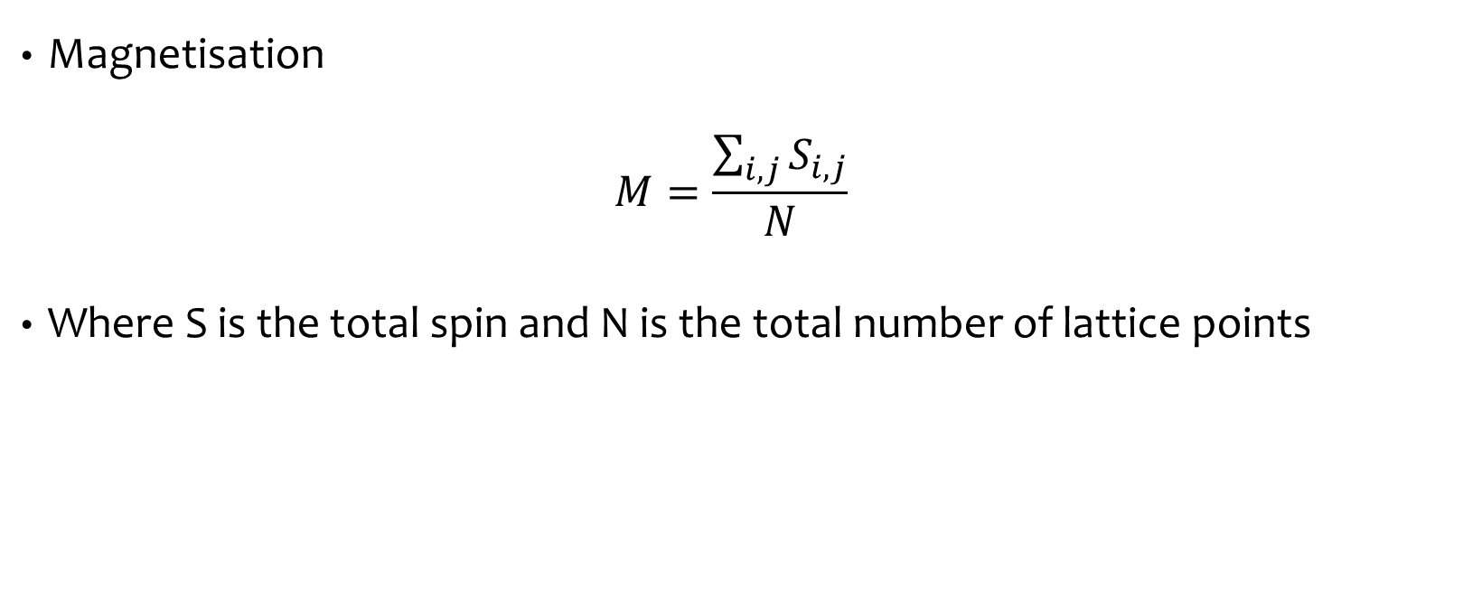
Magnetisation vs Temperature
Magnetisation
$$M=\frac{\sum_{i,j}{S_{i,j}}}{N}$$
Where S is the total spin and N is the total number of lattice points
Notes:
Take Ising Model, randomise the lattice - high temperature
Slowly decrease temperature in increments to measure magnetization at each step

Slide 23
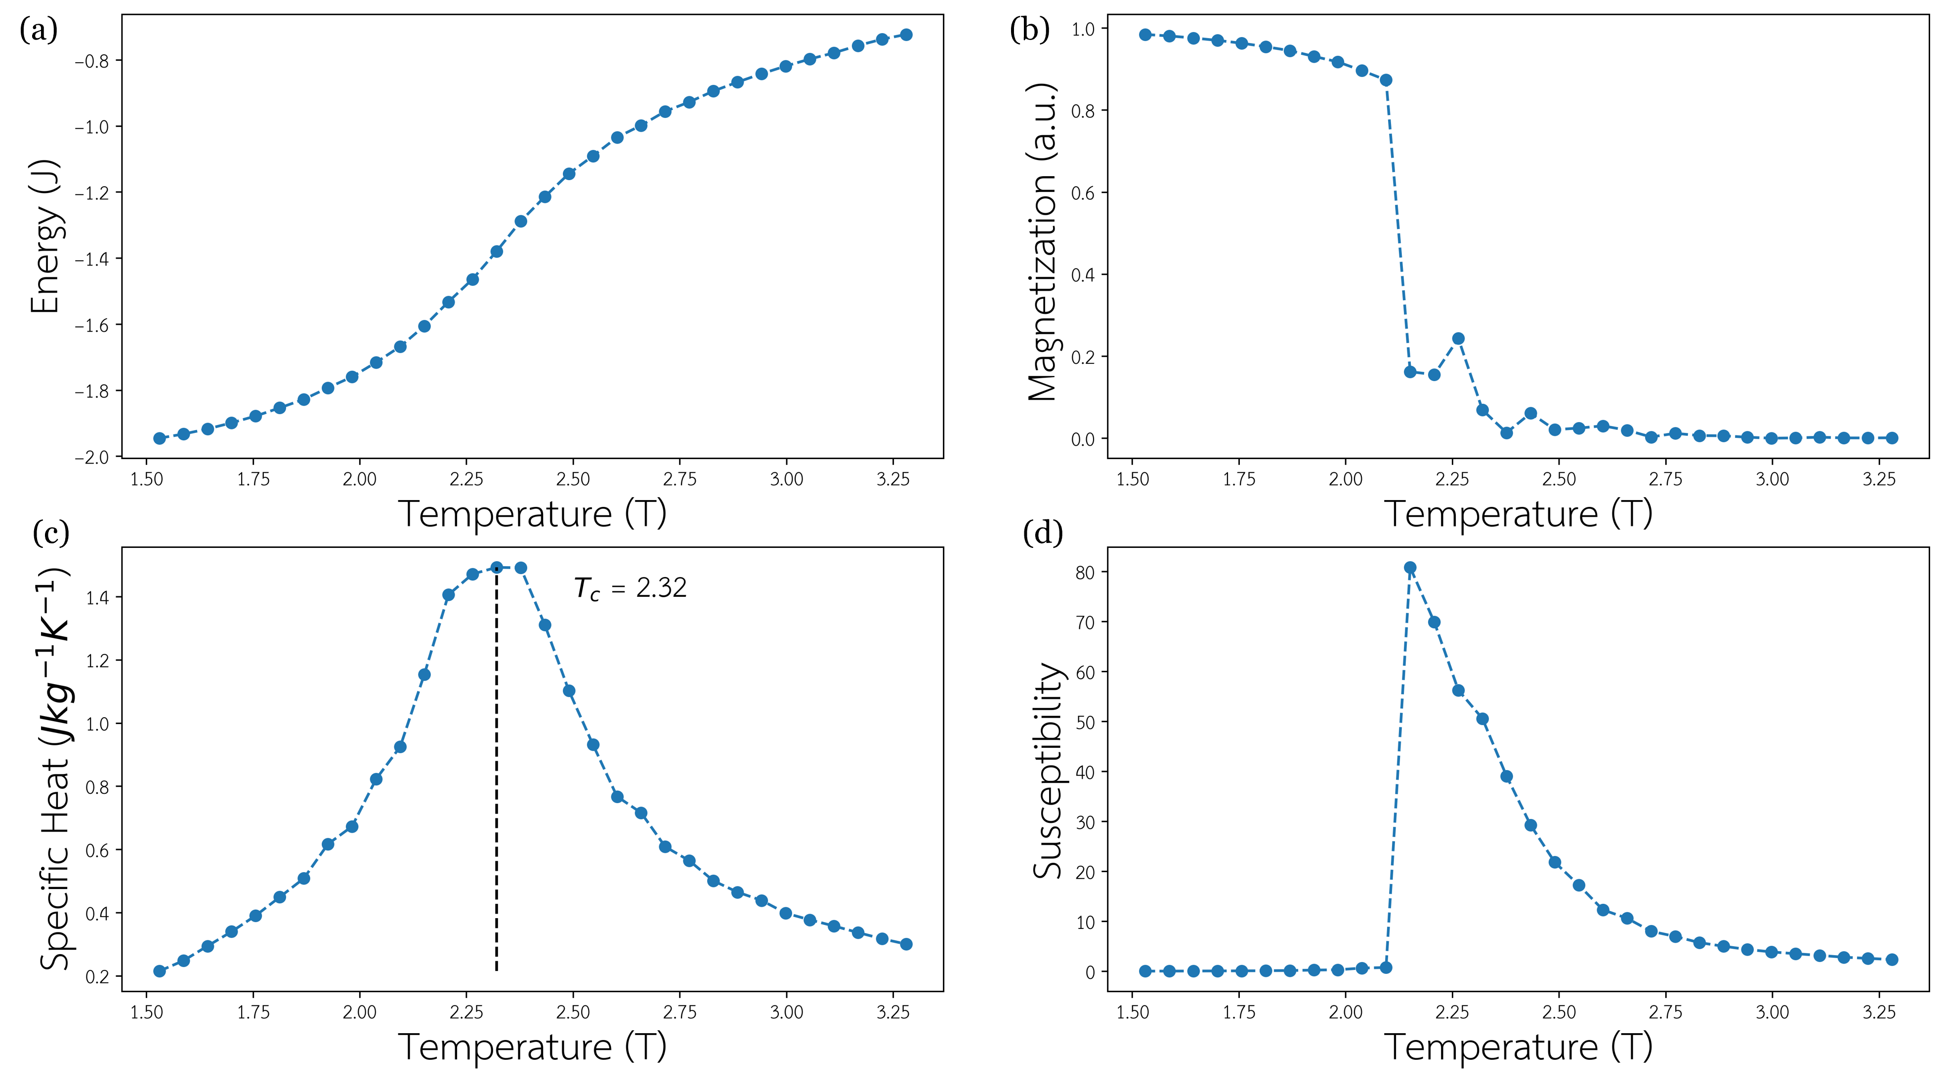
Notes:
Equilibrate – 25600 steps
MC for measurement – 51200 steps
Curie temperature found around 2 degrees – phase transition between PM and FM
Agrees with literature, around 2.27

Slide 24
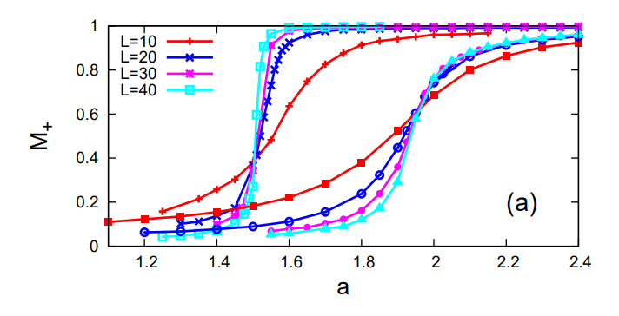
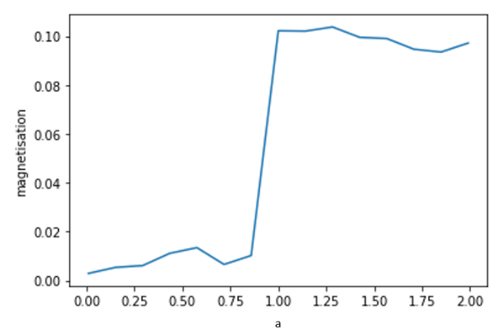

PM-FM Transition
PhD thesis: Two-dimensional spin-ice and the sixteen-vertex model, Demian Levis, LPTHE 2005.
$$a=e^{\frac{−Δ}{T}}$$
$$T=−\frac{Δ}{ln⁡(a)}$$
Notes:
Here, temperature of system controlled by varying the weight of a
The rest are fixed
When running this, the phase transition is found at around a weighting of 1
This is the figure I was reproducing to verify the system was working
Found potential issue
X axis is Boltzmann weighting, given by this equation
Rearranged, we see that positive a values -> negative tempratures

